Slide 1













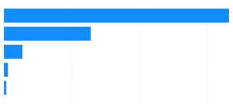





Power BI Desktop
ADVENTURE WORKS CYCLES
CUSTOMER RETENTION
TABs
1
2
Filters Menu
$25M
Total Sales
$10M
Gross Margin
41.97%
Gross Margin %
17K
Total Customers
25K
Total Order
1809
Returned Orders
Home Page
Total Sales by AgeGroup
Cohort
1
2
3
4
5
6
7
8
9
10
11
12
13
14
15
16
17
41-60 61-80
$16.7M
2015-01
2015-02
2015-03
2015-04
2015-05
2015-06
2015-07
2015-08
2015-09
2015-10
2015-11
2015-12
2016-01
2016-02
$6.4M
10%
Revenue
<=40
$1.4M
12%
16%
Analysis
Above 80
$0.3M
4%
19%
8%
(Blank)
$0.2M
1%
10%
19%
8%
$0M
$5M
$10M
$15M
1%
1%
13%
17%
2%
Product Analysis
3%
3%
7%
24%
3%
5%
1%
3%
1%
8%
22%
3%
1%
Total Sales by IncomeGroup
5%
4%
5%
7%
11%
12%
6%
12%
$12.0M
2% 2% 5% 7% 19% 9% 1% 9% 6%
Return Analysis
$10M
$9.6M
Total Sales
3%
1% 5% 9% 10% 24% 2% 15% 11% 4%
$5M
$3.2M
5%
2%
4% 2% 8% 13% 10% 6% 13% 5% 14%
$0.2M
8%
4%
4%
3% 10% 13% 19% 13% 7% 5% 7% 21%
$0M
(Blank)
Customer Analysis
Medium Income
Low Income
High Income
8%
9%
6%
7%
7% 15% 12% 19% 10% 8% 5% 13%

Slide 2



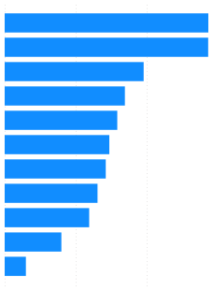
Power BI Desktop
ADVENTURE WORKS CYCLES
CUSTOMER RETENTION
TABs
1
2
Filters Menu
$25M
Total Sales
$10M
Gross Margin
41.97%
Gross Margin %
17K
Total Customers
25K
Total Order
1809
Returned Orders
Home Page
Customer Segmentation
Customers by Segment
First Occupation Professional
Professional
Professional
Professional
Professional
Professional
Professional
Professional
Professional
Professional
Professional
Management
Management
Management
Skilled Manual
Skilled Manual
Skilled Manual
Clerical
Skilled Manual
Skilled Manual
First MaritalStat Married
Single
Married
Single
Single
Single
Married
Single
Single
Single
Married
Married
Married
Single
Single
Married
Single
Single
Single
Single
CustomerKey

11000 11001 11002 11003 11004 11005 11007 11008 11009 11010 11011 11012 11013 11014 11015 11016 11017 11018 11019 11020
First EmailAddress
jon24@adventure-works.com eugene10@adventure-works.com ruben35@adventure-works.com christy12@adventure-works.com elizabeth5@adventure-works.com julio1@adventure-works.com marco14@adventure-works.com rob4@adventure-works.com shannon38@adventure-works.com jacquelyn20@adventure-works.com No
First HomeOwner
Yes No Yes No Yes Yes Yes Yes No
New Customers
2.9K
Revenue Analysis
Promising
2.9K
Cannot Lose Them
2.0K
Champions
1.7K
At Risk
1.6K
Product Analysis
Lost customers
1.5K
Hibernating custo…
1.4K
curtis9@adventure-works.com lauren41@adventure-works.com ian47@adventure-works.com sydney23@adventure-works.com chloe23@adventure-works.com wyatt32@adventure-works.com shannon1@adventure-works.com clarence32@adventure-works.com luke18@adventure-works.com jordan73@adventure-works.com
Yes Yes Yes No No Yes Yes Yes No No
Loyal
1.3K
Return Analysis
About To Sleep
1.2K
Potential Loyalist
0.8K
Need Attention
0.3K
Customer
0K
1K
2K
3K
Analysis

Slide 3

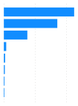
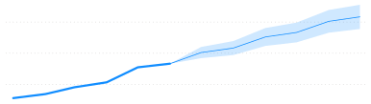


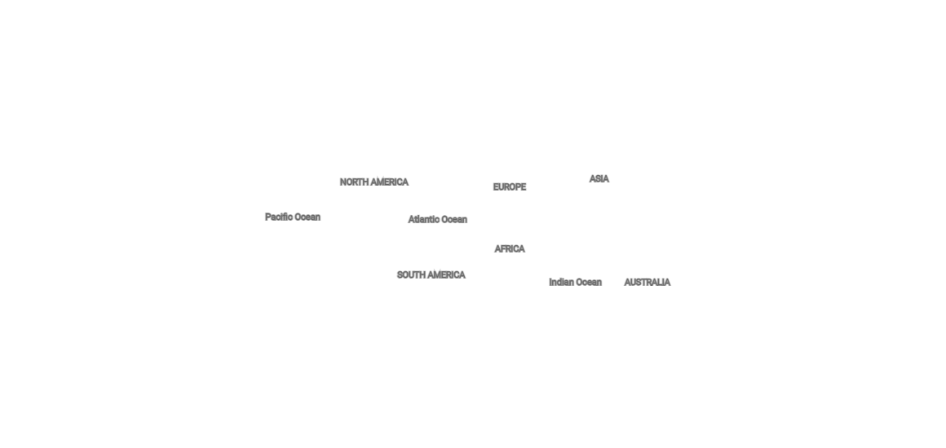
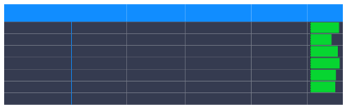
Power BI Desktop
ADVENTURE WORKS CYCLES
REVENUE ANALYSIS
2015
2016
2017
Filters Menu
$25M
Total Sales
$10M
Gross Margin
41.97%
Gross Margin %
17K
Total Customers
25K
Total Order
1809
Returned Orders
Home Page
Total Sales by Category
Top 10 SubCategory by Sales
Total Sales/Forecast Trend
$1M (3.64%)
Road Bik… Mountai… Touring … Tires an… Helmets Jerseys Bottles a… Fenders
$11.3M
$3.0M
$8.6M
$2.5M
Revenue
$3.8M
Analysis
$0.4M
$2.0M
$0.2M $0.2M $0.1M $0.1M
$1.5M
$24M (94.89%)
Product Analysis
Bikes
Accessories
Clothing
$0M
$5M
$10M
$1.0M
Jan 2017
Mar 2017
May 2017
Jul 2017
Sep 2017
Nov 2017
Sale Summarize By Country
United States
United Kingdom
Country
United States Australia United Kingdom Germany France Canada Total
Total Sales
Gross Margin

Gross Margin %
Total Sale LY
YOY %
Return Analysis
$7,938,999 $7,416,456 $2,902,562 $2,524,680 $2,362,643 $1,769,246 $24,914,587
$3,364,542 $3,077,023 $1,214,774 $1,054,186 $989,346 $757,844 $10,457,715
42.38% 41.49% 41.85% 41.76% 41.87% 42.83% 41.97%
$4,808,240 $5,008,351 $1,783,474 $1,509,023 $1,488,889 $1,131,160
65.11% 48.08% 62.75% 67.31% 58.68% 56.41%
Canada
France
Germany
Australia
Customer Analysis
$15,729,137 58.40%
© 2024 Miicrrosofftt Corrporrattiion

Slide 4


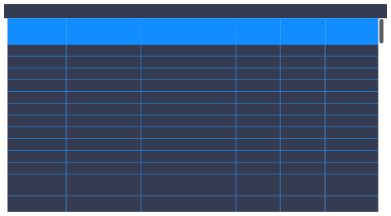
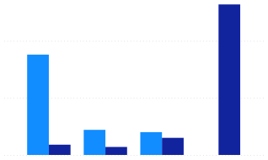
Power BI Desktop
ADVENTURE WORKS CYCLES
PRODUCT ANALYSIS
2015
2016
2017
Filters Menu
$25M
Total Sales
$10M
Gross Margin
41.97%
Gross Margin %
17K
Total Customers
25K
Total Order
1809
Returned Orders
Home Page
293
130
163
84K
Count of Product
Product with Sales
Product without Sales
Total Quantity Sold
Revenue
Chart
Table
Analysis
Product with Sales and Product Without Sales by Category
Product Ranking Based on Gross Margin %
Product with Sales
Product without Sales
CategoryName
SubcategoryName
ProductName
Total Sales
Gross Margin %

Rank Product
132
Accessories Accessories Accessories Accessories Accessories Accessories Accessories Accessories Clothing Clothing Clothing Clothing
Helmets Helmets Fenders Bike Racks Bike Stands Cleaners Tires and Tubes Tires and Tubes Vests Vests Vests Shorts
Sport-100 Helmet, Black Sport-100 Helmet, Blue Fender Set - Mountain Hitch Rack - 4-Bike All-Purpose Bike Stand Bike Wash - Dissolver HL Mountain Tire HL Road Tire Classic Vest, L Classic Vest, M Classic Vest, S Women's Mountain
Shorts, L
Women's Mountain
$65,270 $67,120 $87,041 $36,240 $37,206 $13,563 $45,675 $25,917 $11,557 $11,557 $9,970 $23,377
64.25% 64.25% 62.60% 62.60% 62.60% 62.60% 62.60% 62.60% 62.60% 62.60% 62.60% 62.60%
1 1 3 4 4 4 4 4 4 4 4 12
Product Analysis
100
88
Return Analysis
50
22
20
15
9
7
Customer Analysis
0
Bikes
Accessories
Clothing
Components
Clothing
Shorts
$22,887
62.60%
12

Slide 5


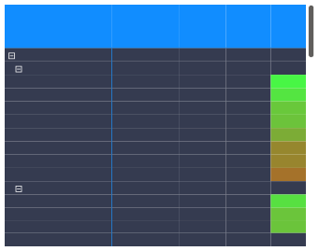
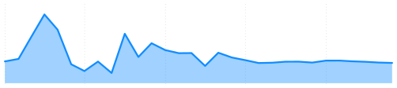
Power BI Desktop

ADVENTURE WORKS CYCLES
SALES RETURN ANALYSIS
2015
2016
2017
Filters Menu
$25M
Total Sales
$10M
Gross Margin
41.97%
Gross Margin %
17K
Total Customers
25K
Total Order
1809
Returned Orders
Home Page
1828
2.17%
$765K
84K
Total Amount Returned
Total Quantity Sold
Quantity Returned
Return rate
Revenue
Order Returned by Continent, Category and Product
Returned rate Trend
Analysis
Continent
6.86%
Total Amount Returned
Quantity Returned
Total Quantity Sold
Return rate

4.93%
3.99%
North America
Accessories
Cleaners
Fenders
Tires and Tubes
Bottles and
Hydration Packs
Helmets
Bike Racks
Bike Stands
$273,279 $10,782 $64 $703 $4,037 $1,091 $495 $3,036 $720 $636 $5,708 $199 $659 $108
$765,278
871
569
8
32
273
148
9
89
6
4
144
23
28
12 1828
40717 2.14%
29109 1.95%
0.88%
1.24%
1.86%
1.96%
2.46%
3.22%
3.28%
3.67%
6263 2.30%
1.34%
1.93%
1.94% 84174 2.17%
2.16%
3.04%
Product Analysis

905
2572
14651
7563
366
2760
183
109
2.17%
1.02%
2.62%
2.02%
1.21%
Jul 2015
1.72%
Jan 2015
Jan 2016
Jul 2016
Jan 2017
Quantity Returned by Country
Top 10 Returned Products
Return Analysis
United States Australia Canada United King… France Germany
633
Water Bottl… Patch Kit/8… Mountain … Mountain … Sport-100 … Road Tire T…
155

404
95
Clothing
238
93
Caps
Gloves
Socks
1715
1452
619
204
77
Customer Analysis
186
70
163
67
Total

